Slide 1


Supervised Classification
Tom Zimmerman
IBM Research-Almaden
Nov 16, 2020
This material is based upon work supported by the NSF under Grant No. DBI-1548297.
Disclaimer: Any opinions, findings and conclusions or recommendations expressed in this material are those of the authors and do not necessarily reflect the views of the National Science Foundation.

Slide 2
CSC698 Monday Oct 19, 2020
Lecture: Supervised Classification (50 min)
Iris dataset, scikit variable labels, measuring performance
Intro to k-Nearest Neighbor (kNN) and Support Vector Machine (SVM)
Break (10 min)
Q&A (15 min) Supervised Classification w/class coding
Wed Mini-Assignment
Python Skills: Write one code example using iris dataset
e.g. cluster with 3 features, 3D scatter plot
Add news functions to cheat sheets

Slide 3
CSC698 Wednesday Oct 21, 2020
Review: Reject grid image with mouse, save list (20 min, 12:30 to 12:50 pm)
Homework #10 Assignment review (10 min, 12:50 to 1:00 pm)
Mini-Assignment Breakout Rooms (20 min, 1:00 to 1:20 pm)
Python Skills Code Demo
Review Cheat Sheets
Group Discussion (25 min, 1:20 to 1:45 pm)
Python Skills Code Demo
Review Cheat Sheets

Slide 4
Homework #10 Assignment Assigned: Wednesday 21 Oct 2020 Due: Tuesday 27 October 2020 11:59 PM
1. Viewing Clustering Results
Please upload the program you wrote to create the cluster grid images in Homework #9 (before weekend!). DELIVERABLES:
Upload your cluster grid image code from Homework #9 (gridImageCreator.py) by Friday.
2. Review
Review scope, especially in functions and nested loops https://realpython.com/python-scope-legb-rule/
Review your metric prefixes.
DELIVERABLES:
Write three things you learned about scope, and the four most common prefixes you work with in the lab or class. Submit as a pdf document.
3. Fun with Mice (a) Run showAllEvents_v2.py
(b) Use your mouse and list all the mouse events you could generate.
(c) Run processMouseExample_v1.py
(d) Write a simple program that generates any text or graphic output when (1) move the mouse, (2) click the left button down and (3) click the right button down. For inspiration, see https://www.pyimagesearch.com/2015/03/09/capturing-mouse-click-events-with-python-and-opencv/
DELIVERABLES:
From (b), upload your “what events I could generate” pdf document.
From (d) upload your simple program that demonstrates text or graphic output generated by mouse actions.
4. Create Labeled Training Set
Using ViewVideo_v3.py as your base code write a program that
Creates of two-dimensional gridArray with rows=number of images in a grid and col=3 (OBJ_INDEX=0, CLUSTER=1, STATUS=2)
Selects images for one cluster (you decide which cluster), puts it in the grid, and adds the object to the gridArray (status=0)
When complete, saves the cluster image as “clusterN_raw.jpg” where N is the cluster you selected
Allows the user to use the left button to eliminate images from the cluster and set the object status to 1 (gridArray[gridIndex,STATUS]=1). Hint: Look at processMouseExample_v1.py
When the user hits ‘s’, save the edited cluster image as “clusterN_edit.jpg” and the gridArray as “gridArray_N.csv”. When ‘q’ hit, end program.
DELIVERABLES:
From (c) and (e) upload your two images “clusterN_raw.jpg” and “clusterN_edit.jpg”.
From (a) to (e) Upload your finished “createTrainingSet.py” program and any modules you created that it calls.

Slide 5
CSC698 Monday Oct 26, 2020
Code Review (50 min)
Structuring Programs: functions, calling modules, shared constants, testing
Homework #10 preparation; grid construct, remove cell images w/mouse
Break (10 min)
Q&A, Mini-Lecture (15 min)
Code review Q&A
Principle Component Analysis (PCA), new species video
Wed Mini-Assignment
Prof K. Reminder on Mini-Assignments
Python Skills: Write one code example using mouse and display demonstrating a Graphical User Interface (GUI) (e.g. select, draw, save)
Add news functions to cheat sheets

Slide 6
CSC698 Monday Nov 2, 2020
Code Review (35 min)
Design example (how many members in each cluster)
Homework #9 general solution
Break (10 min)
Image Pipeline Review (30 min)
New multi-species video
DetectTrackFeature pipeline
(if there is time) Principal Component Analysis (PCA)
Wed Mini-Assignment
Python Skills: Write one program from scratch that analyzes the multi-species video (e.g. plot frame brightness vs frame number, # objects with good area vs frame number, inertia vs cluster numbers, detect video splices)
Add news functions to cheat sheets

Slide 7
CSC698 Wednesday Nov 4, 2020
Review: detectTrackFeatureCluster modules (20 min, 12:30 to 12:50 pm)
Homework #11 Assignment review (10 min, 12:50 to 1:00 pm)
Mini-Assignment Breakout Rooms (20 min, 1:00 to 1:20 pm)
Python Skills; New code that includes reading multi-species plankton video
Review Cheat Sheets
Group Discussion (25 min, 1:20 to 1:45 pm)
Python Skills Code Demo
Review Cheat Sheets

Slide 8
Homework #11 Assignment Assigned: Wednesday 4 Nov 2020 Due: Tuesday 10 Nov 2020 11:59 PM
SPECIES ASSIGNMENTS
indexTime, Species, Student
0:0, blep, Faye, Amisha, Tommy
0:15, did, Gilbert, Cara, Daisy
0:25, dil, Alennie, Lorena, Anthony
0:34, eup, Patra, jessenia, Anneke
0:47, par, Madu, Berenice, Carolyn
0:56, ste, Kiana, Inderdeep
1:04, vol, Maxamillian, Johnny
1. Create objectArray File for Assigned Species
(a) Each student is assigned a species. Find the location (start and stop frame numbers) of your assigned species by viewing movie and printing out frame numbers.
(b) Edit the detectTrackFeatureCluster program to create and save an objectArray file at the start and stop frame locations of your assigned species.
Hint: Start the video by pointing to the first frame of your selected species using the command cap.set(cv2.CAP_PROP_POS_FRAMES, startFrame), and set MAX_FRAME in the Common_4.py file to the last frame of your selected species.
(c) Save the objectArray file with the following name format; species_tz.csv where “species” is the species you were assigned (e.g. “blep”, “did”, “dil”, etc) and tz are your name initials.
DELIVERABLES:
(a) The objectArray file in the format specified above (see (c)).
(b) The program file(s) you edited to create the objectArray for your species.
2. Clusters
Run ViewCluster_2.py for your video and objectArray file.
Save an image of the cluster 3D scatter plot. This should be for number of clusters = 5 (the default value in Common_4.py file)
DELIVERABLES:
An image of the cluster 3D scatter plot.

Slide 9
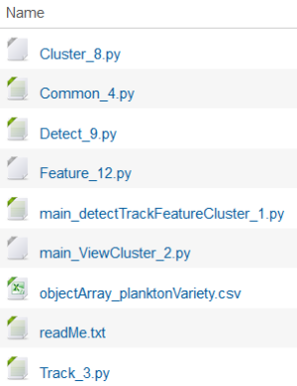
Homework #11 Plankton Variety
readMe.txt
Program: main_detectTrackFeatureCluster_1.py
Purpose: Performs detection, tracking, feature extraction and clustering of video
Input: video
Output: objectArray.csv
Modules:
Cluster_8.py performs clustering
Common_4.py constants used by all programs
Detect_9.py detects, tracks and extracts features from video. Uses the following modules:
Track_3.py tracks objects
Feature_12.py extracts features from object image (region of interest image)
Program: main_ViewCluster_2.py
Purpose: Displays scatter plot of 3 features, shows frame-by-frame detection of objects in video
Input: video, objectArray.csv
Output: visual display of scatter plot and object detection
Modules:
Common_4.py constants used by all programs
Homework Folder

Slide 10
CSC698 Monday Nov 9, 2020
Homework #12
Lecture: Classification, Feature Processing, PCA, Confusion Matrix
Break (10 min)
Code Demo & Review
Wed Mini-Assignment
No class Wed (11/11) so post assignment in iLearn by Wed for credit
Python Skills: Review code posted in HW#12. Write some code based on new functions you see in posted code.
Add news functions to cheat sheets

Slide 11
Homework #12 Assignment Assigned: Monday 9 Nov 2020 Due: Tuesday 17 Nov 2020 11:59 PM
1. Understanding Principal Component Analysis (PCA)
Read https://builtin.com/data-science/step-step-explanation-principal-component-analysis
Answer the following questions;
What is principal component analysis (PCA)?
Why do we standardize our features before performing PCA?
What is a covariance matrix?
What is variance and how is it calculated?
What are eigenvectors and eigenvalues? (this video give a more detailed explanation https://youtu.be/PFDu9oVAE-g)
Deliverable: Write your answers to the questions above and submit them as a pdf file named pcaReading.pdf
2. Identify Plankton in Clusters
(a) Using the trainVariety_P3.csv objectArray file and your grid clustering program from Homework #9, view and identify images of plankton in each cluster (e.g. blep,did,dil,eup,par,ste,vol). If object is not one of these give them unique names like alg1, alg2 (for algae types) or un1, un2 (for unknown types).
(b) Edit Lines 42 and 43 of “Main_Classification_Confusion_V1.py” with these new labels, e.g. replace xNames=['a','b','c','d','e','f','g','h','i','j’] with xNames=[‘blep’,’did’,...etc]
(c) Run the program and save the image of “Normalized confusion matrix”.
DELIVERABLE:
(a) Upload the “Normalized confusion matrix” image as “normalizedConfusionMatrix.png”
3. Features, PCA and TEST_SIZE
(a)Run “Main_Classification_Confusion_V1.py “ for 1, 2, and 3 PCA terms by enabling Line 15,16, OR 17 (only enable one of these lines). What is the effect on accuracy?
(b)Repeat (a) with 3 PCA terms and vary the TEST_SIZE (line 25). What is the impact on accuracy
DELIVERABLE:
(a) Upload report document named “PCA_experiments.pdf” describing the effect of PCA terms and TEST_SIZE on accuracy.
4. TEN COLORS
a) Run “Main_ViewCluster_3.py”
b)Modify the program so each of the 10 clusters have their own unique color that matches the rectangle color. [Hint: The “colorTable” must have 10 entries. It currently has only 6 entries].
DELIVERABLES:
(a)Upload your modified code as “Main_ViewCluster_10color_4.py”
(b)Upload an image of the scatter plot showing 10 unique colors as “TenColor.png”

Slide 12
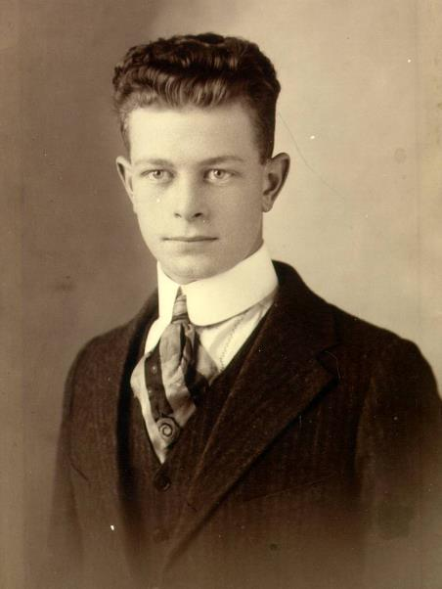
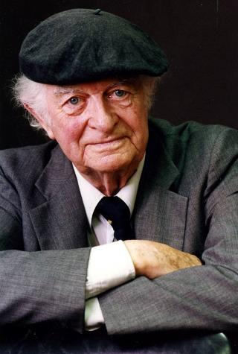
Linus Pauling (1901-1994)
Nobel Prize Chemistry 1954
Nobel Peace Prize 1962
Linus Pauling, Age 17

Slide 13
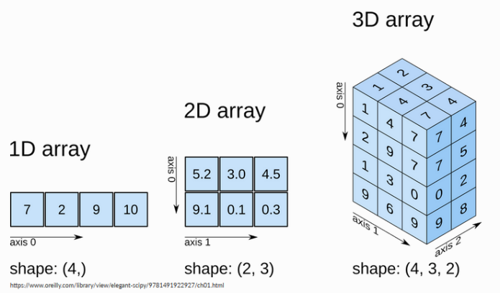
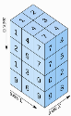
Numpy Array Dimensions
shape=(3,4,8)
Three dimensions
First dimension has 3 elements
Second dimension has 4 elements
Third dimension has 8 elements
4 D array
Array of Counters Grayscale Image Color Image Array of Color Images
[counter] [yPixel,xPixel] [yPixel,xPixel,colorCh] [yPixel,xPixel,colorCh,imageNumber]
https://fgnt.github.io/python_crashkurs_doc/include/numpy.html

Slide 14
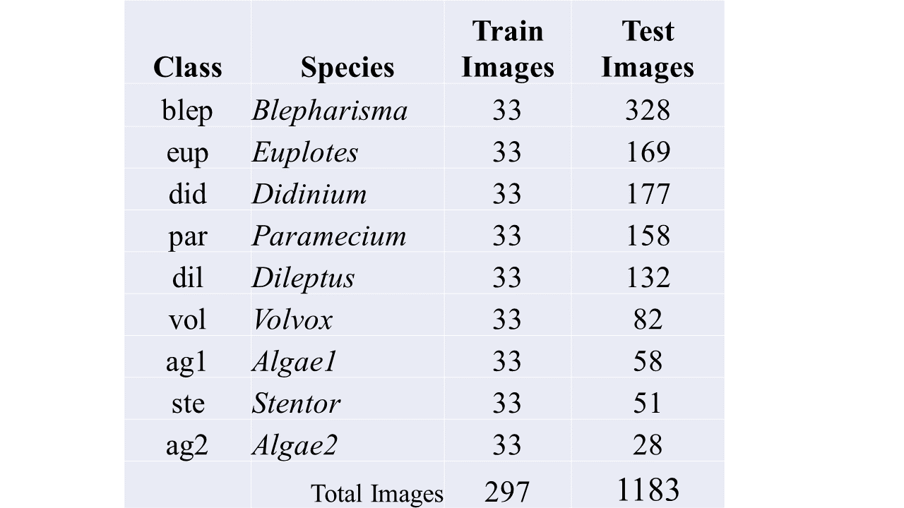
Object Classification Pipeline
Detect
Feature
Unsupervised
Cluster
Curate (hand select)
Training & Testing Dataset
Supervised
Classification
Evaluate
Performance
Label Dataset (Homework #9 and #10)
Create grid of object images from a cluster
Remove out of class images with mouse
Save array indicating object index and object status (in or out of cluster)

Slide 15
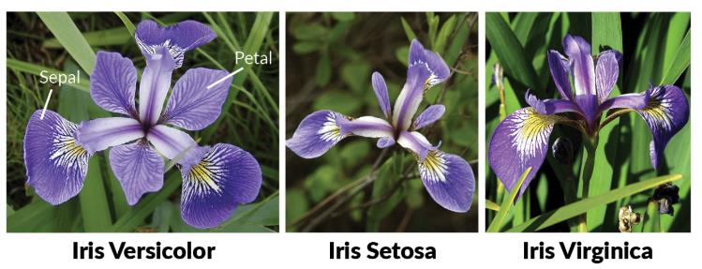
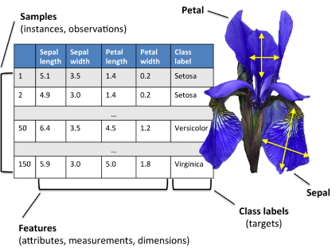
Iris Flower Dataset
50 samples from three species of Iris Flowers — Iris Setosa, Iris Virginica and Iris Versicolor .
British statistician and biologist Ronald Fisher, “The use of multiple measurements in taxonomic problems” (1936)
https://medium.com/analytics-vidhya/exploratory-data-analysis-uni-variate-analysis-of-iris-data-set-690c87a5cd40

Slide 16
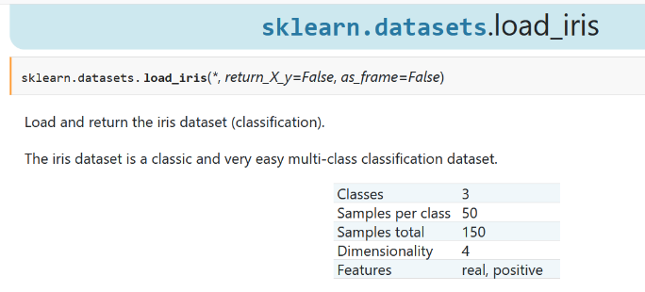
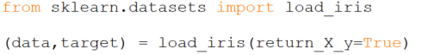
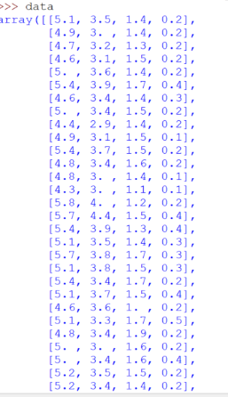
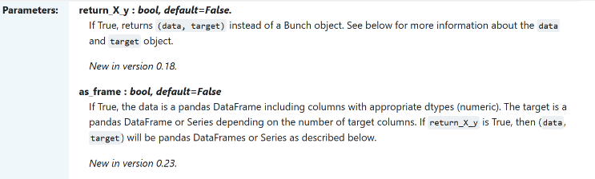
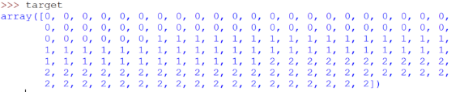
https://scikit-learn.org/stable/modules/generated/sklearn.datasets.load_iris.html

Slide 17
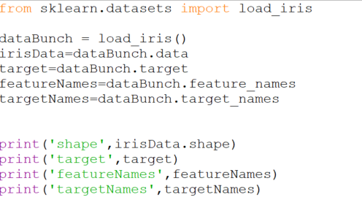
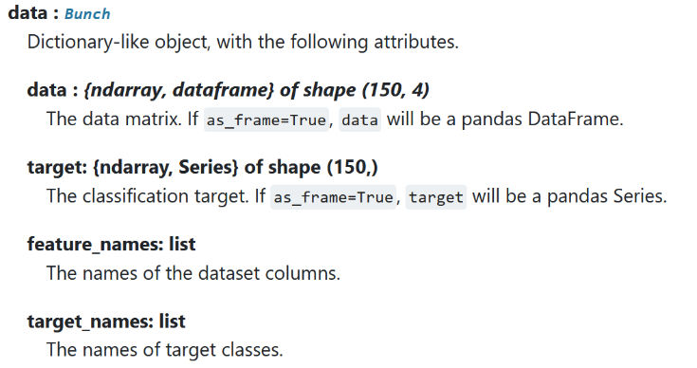
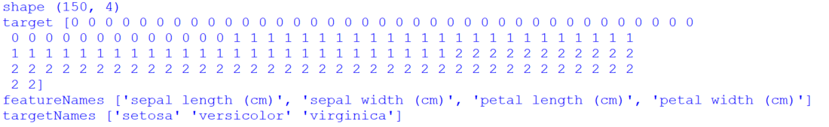
Data Bunch

Slide 18
Scikit-learn Variable Label Convention for Classification
X are Features
y are Classes
Classification: given a set of features (X), predict the class (y)
For example X[]=plankton area, aspect ratio and texture, y[]=blepherisma
X_train = features from training set
X_test = features from test set
y_train = class from training set
y_test = class from test set (you usually don’t know this)
classifier.fit(X_train, y_train) # train on known features for classes
y_predict = classifier.predict(X_test) # given features, predict class
accuracy = accuracy_score(y_test, y_predict) # compare predicted class (y_predict) with ground truth class (y_test)
confusion_matrix(y_test, y_predict) # plot matrix of predicted class compared to ground truth class

Slide 19
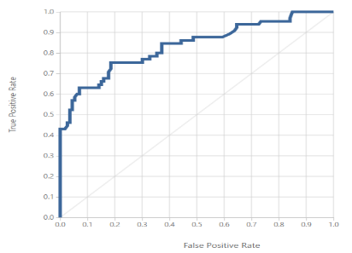
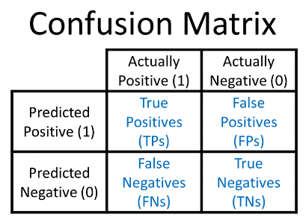
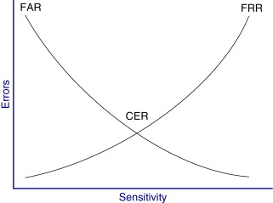
Evaluation Classification Performance
Receiver Operating Characteristic (ROC) Curve
Equal Error Rate (EER): Equal probability of mis-classifying a positive or negative sample
elbow=EER
*
random
guess line
True Positive (Recall)
Area Under the Curve (AUC) is an indicator of the overall quality of a ROC curve
False Positive
Biometric Application
True Positives (TPs): + examples correctly classified as +
True Negatives (TNs): - examples correctly classified as -
False Positives (FPs): - examples incorrectly classified as +
False Negatives (FNs): + examples incorrectly classified as -
FP
False Reject Rate
False Acceptance Rate
Accuracy = (TP+TN)/(TP+FP+FN+TN) how many correct
Precision=TP/(TP+FP) how many positives correctly predicted
Recall (Sensitivity)= TP/(TP+FN) how many positives for all samples
F1 Score=2*(Precision*Recall)/(Precision+Recall) weighted avg of P&R
Terrible Security
But everyone gets in
(Lots of FP)
EER
Great Security
But no one gets in
(Lots of FN)
Threshold
https://glassboxmedicine.com/2019/02/17/measuring-performance-the-confusion-matrix/ https://blog.exsilio.com/all/accuracy-precision-recall-f1-score-interpretation-of-performance-measures/

Slide 20
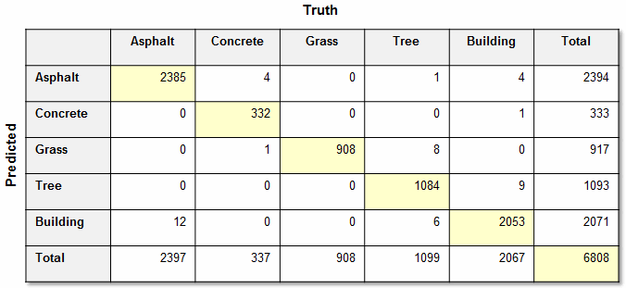
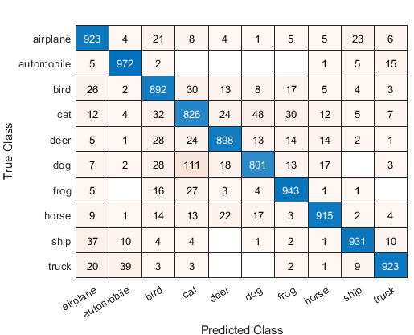
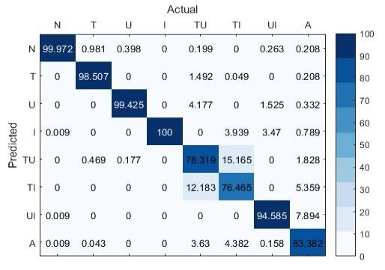
Confusion Matrix Examples

Slide 21
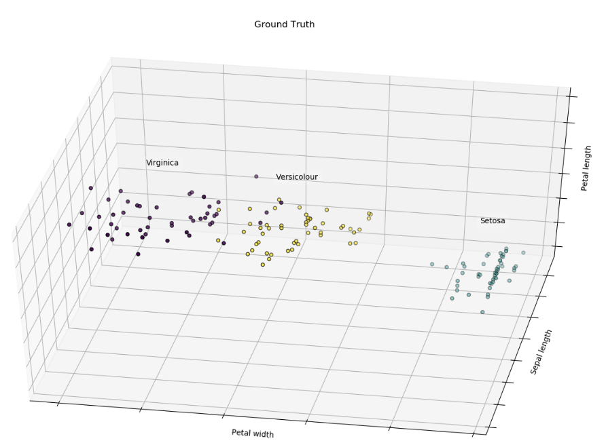
Iris Flower Dataset

Slide 22
Nearest Neighbor
a
c
d
b

Slide 23
Linear Support Vector Machine (SVM)
a
c
d
b

Slide 24
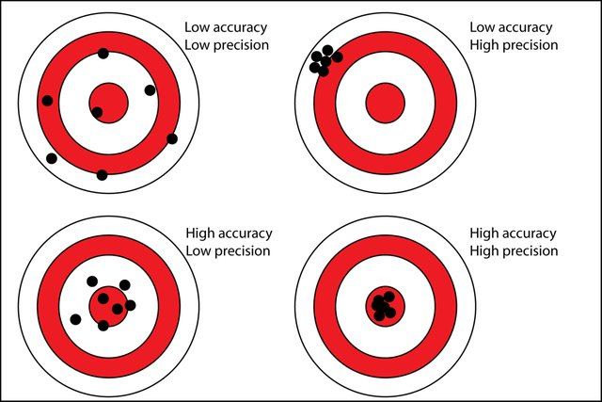
Accuracy vs. Precision
https://www.researchgate.net/profile/Anni_Helena_Ruotsala/publication/304674901/figure/fig6/AS:668649476067338@1536429866393/Precision-versus-accuracy-The-bullseye-represents-the-true-value-eg-the-true_W640.jpg

Slide 25
Function or Procedure?.....=>
FUNCTION
A Function is a series of Python statements begins by a def , followed by the function name and enclosed in parenthesis. A Function may or may not return a value.
A Function procedure can take arguments (constants, variables, or expressions that are passed by a calling procedure).
In general, a procedure is a sequence of instructions. A function can be the same, but it usually returns a result.
A Function is a series of Python statements begins by a def, followed by the function name and enclosed in parenthesis. A Function may or may not return a value.
A Function procedure can take arguments (constants, variables, or expressions that are passed by a calling procedure).
A Function is a series of Python statements begins by a def, followed by the function name and enclosed in parenthesis. A Function may or may not return a value. A Function procedure can take arguments (constants, variables, or expressions that are passed by a calling procedure).

Slide 26
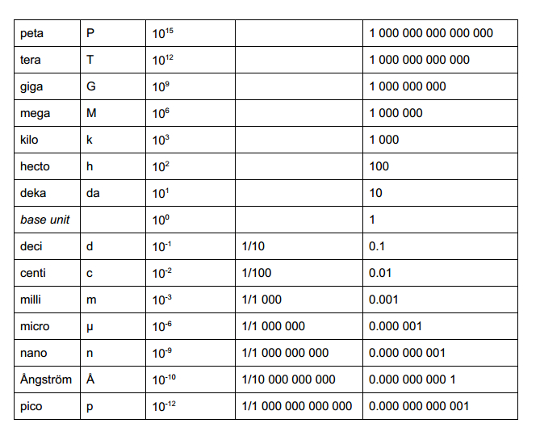
Metric Prefixes
https://heathermicrobiologyjackson.wordpress.com/2013/06/12/an-introduction-to-metric-prefixes/

Slide 27
CODE REVIEW

Slide 28
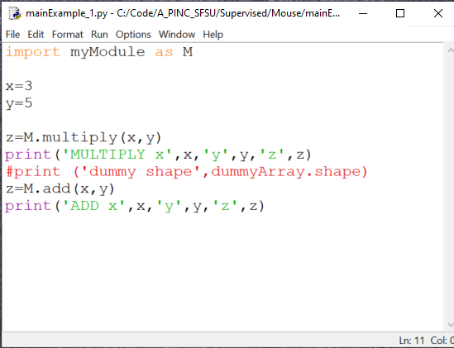
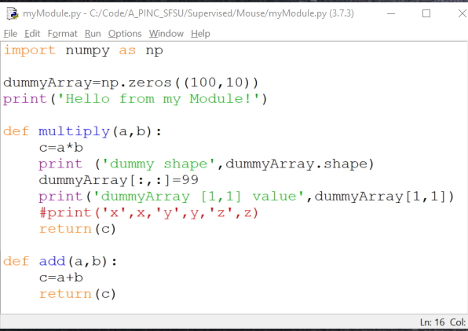
Calling Modules
Main program importing one module and calling two function from module
Module containing two functions
# M.multiply(x,y) is the same as myModule.multiply(x,y)

Slide 29
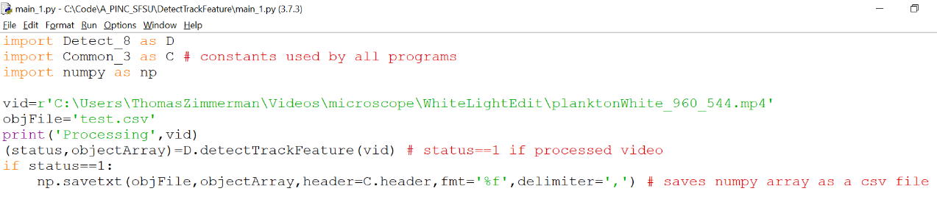
main_1.py
Example of Using Functions to Make Code
Readable and Manageable

Slide 30
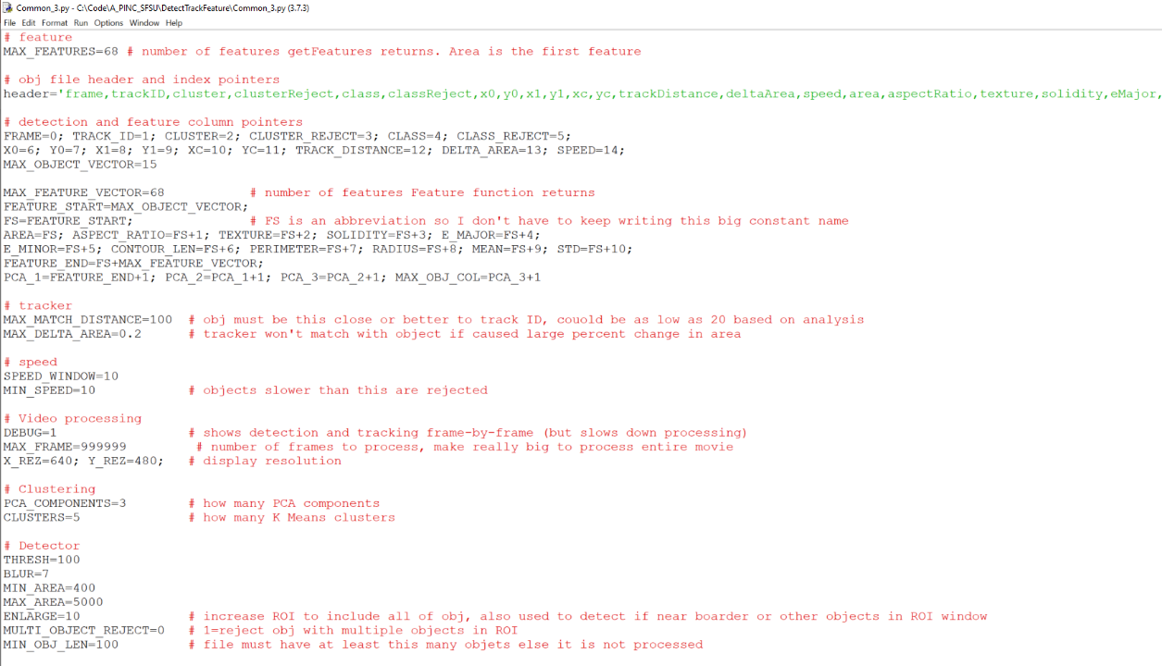
Constants Used By ALL Functions
Common_3.py
1
2
3
4
5
6
7
8
9
10
11
12
13
14
15
16
17
18
19
20
21
22
23
24
25
26
27
28
29
30
31
32
33
34
35
36
37
38
39

Slide 31
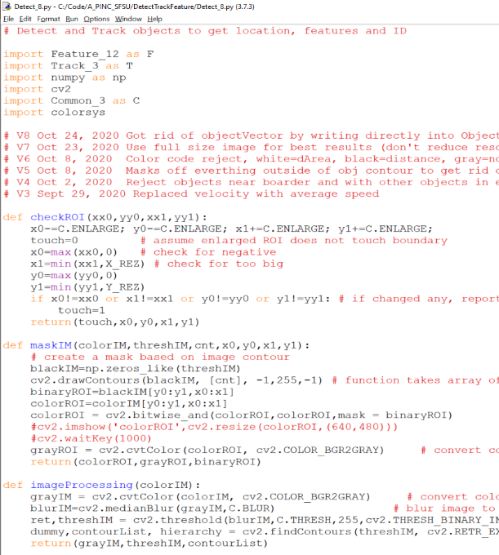
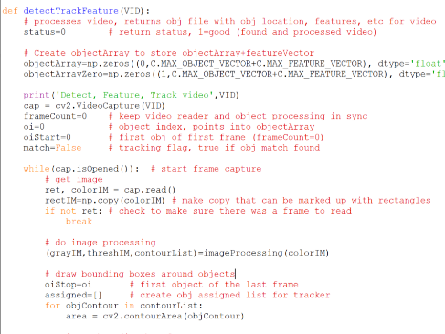
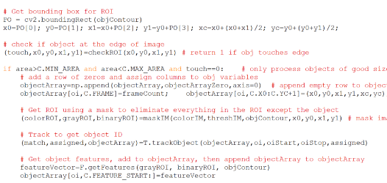
1
2
3
4
5
6
7
8
9
10
11
12
13
14
15
16
17
18
19
20
21
22
23
24
25
26
27
28
29
30
31
32
33
34
35
36
37
38
Detect_8.py
1
2
3
4
5
6
7
8
9
10
11
12
13
14
15
16
17
18
19
20
21
22
23
24
25
26
27
28
29
30
31
32
33
34
35
)
)
. . .
return(status,objectArray)

Slide 32
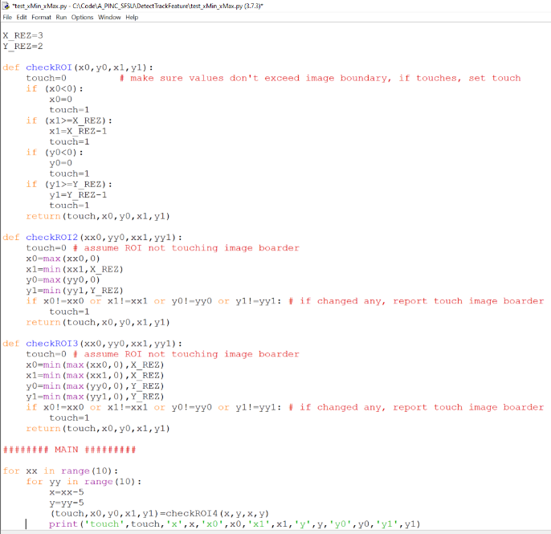
Developing and Testing Simple, Compact Robust Function
Function: Enlarge bounding box to make sure all of object in bounding box. If enlarged box touches frame boarder, reject object.
Need flag to indicate enlarged bounding box is touching frame boarder.
1
2
3
4
5
6
7
8
9
10
11
12
13
14
15
16
17
18
19
20
21
22
23
24
25
26
27
28
29
30
31
32
33
34
35
36
37
ORIGINAL
COMPACT
COMPACT & ROBUST

Slide 33
c=max(a,b) c= larger of a, b
e=min(c,d) e= smaller of c,d
e=min(max(a,b),d)
255
128
0
100
255
0

Slide 34
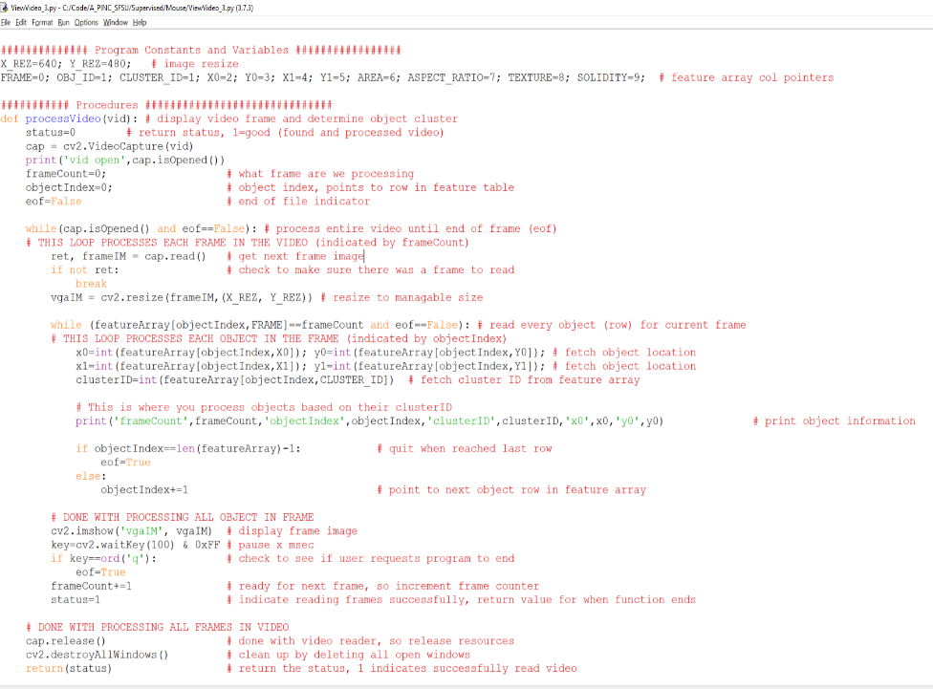
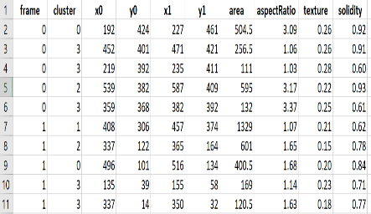
ViewVideo_3.py
f=objectArray [objectIndex,column index]
1
2
3
4
5
6
7
8
9
10
11
12
13
14
15
16
17
18
19
20
21
22
23
24
25
26
27
28
29
30
31
32
33
34
35
36
37
38
FRAME=0; CLUSTER_ID=1; X0=2; Y0=3; X1=4; Y1=5; AREA=6; ASPECT_RATIO=7; TEXTURE=8; SOLIDITY=9
objectIndex
0
1
2
3
4
5
6
7
8
9
FRAME
OBJECT

Slide 35
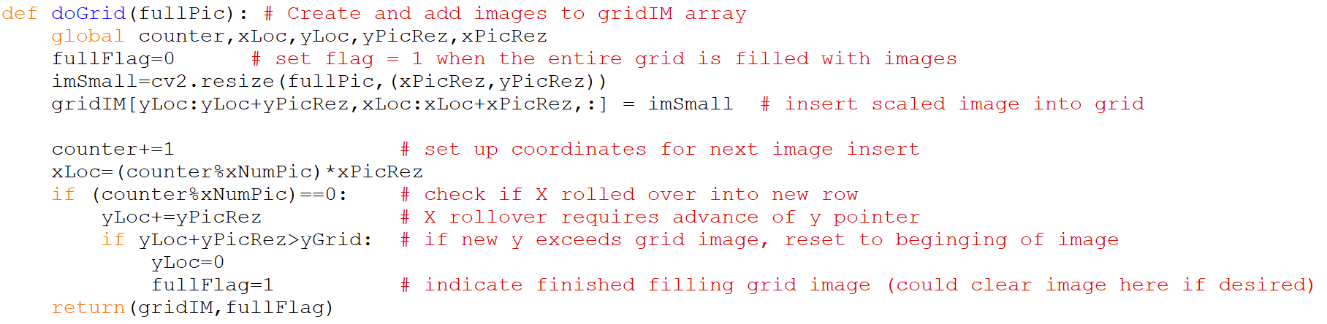
Calling program needs to know when grid is full in order to save finished grid image and start collecting images for next cluster.
NEW VERSION
1
2
3
4
5
6
7
8
9
10
11
12
13
14
15
16
17
18

Slide 36
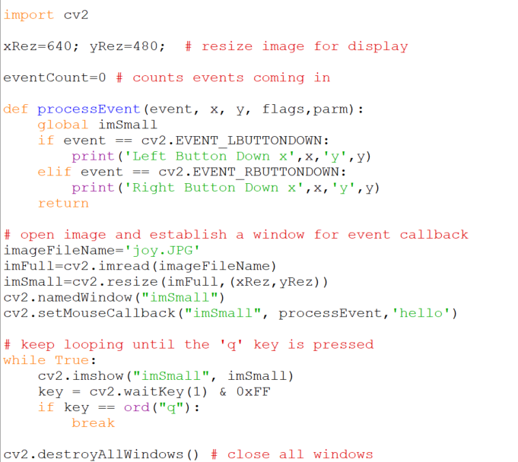
Responding to Mouse in OpenCV
1
2
3
4
5
6
7
8
9
10
11
12
13
14
15
16
17
18
19
20
21
22
23
24
25
26
27
28
29
30
31
32
processMouseExample_v1.py
MOUSE EVENTS
EVENT_FLAG_ALTKEY
EVENT_FLAG_CTRLKEY
EVENT_FLAG_LBUTTON
EVENT_FLAG_MBUTTON
EVENT_FLAG_RBUTTON
EVENT_FLAG_SHIFTKEY
EVENT_LBUTTONDBLCLK
EVENT_LBUTTONDOWN
EVENT_LBUTTONUP
EVENT_MBUTTONDBLCLK
EVENT_MBUTTONDOWN
EVENT_MBUTTONUP
EVENT_MOUSEHWHEEL
EVENT_MOUSEMOVE
EVENT_MOUSEWHEEL
EVENT_RBUTTONDBLCLK
EVENT_RBUTTONDOWN
EVENT_RBUTTONUP
new

Slide 37
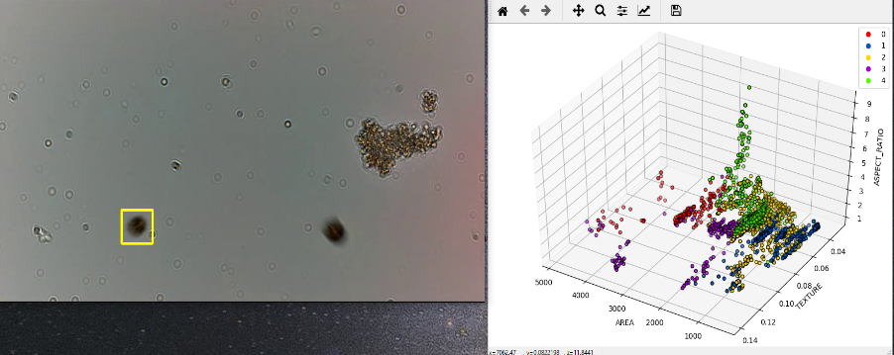
New Video: planktonWhite_960_544.mp4
0:0 blep
0:15 did
0:25 dil
0:34 eup
0:47 par
0:56 ste
1:04 vol

Slide 38
Homework #9 and #10 Helping Slides

Slide 39
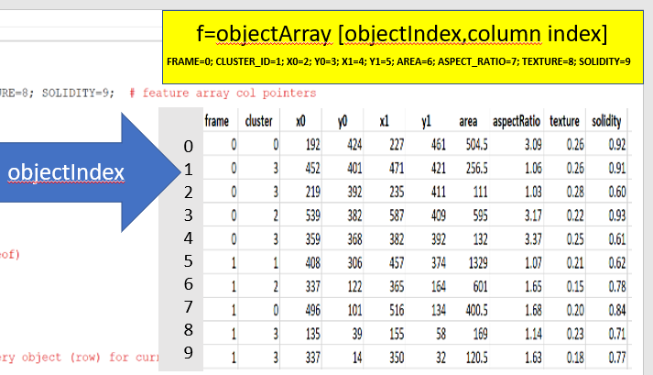
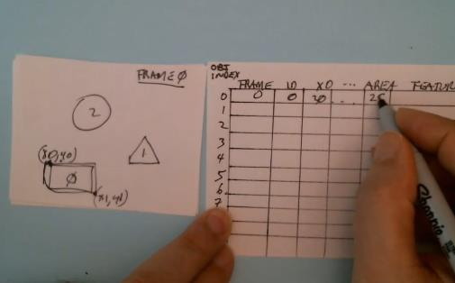
Making an ObjectArray from Video
DetectTrackFeature
Video
objectArray
Tutorial Video

Slide 40
Creating gridArray
Unsupervised
Cluster
Create Grid Image of Cluster
Remove Out-of-Cluster Images
with mouse GUI
objectArray
(from DetectTrackFeature)
gridArray
HW#9
HW#10

Slide 41

objectArray
objectArray[objectIndex,COL_LABEL]
contains all the object information (location, features)
gridArray
gridArray[cluster,gridIndex,OBJECT_INDEX]
what object (from objectArray) did grid image come from
gridArray(cluster,gridIndex,CLUSTER)
what cluster are grid images from
gridArray(cluster,gridIndex,CLUSTER_REJECTION)
was cluster image rejected by user as being out-of-cluster
OBJECT_INDEX CLUSTER _ID CLUSTER_REJECT
1 3
2 3
4 3
cluster
grid index
clusterList
clusterCounter
clusterCounter
clusterCounter
clusterList=[3,1,4] # make cluster images from these clusters
clusterCounter=np.zeros( (C.numClusters) ,dtype='int’)
Counts number of images in each cluster

Slide 42
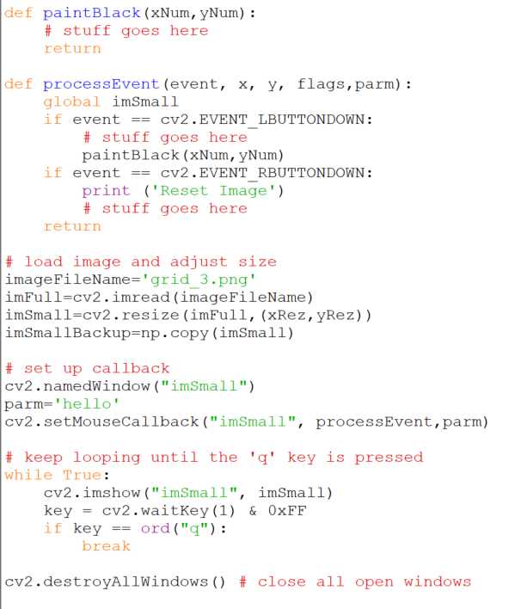
1
2
3
4
5
6
7
8
9
10
11
12
13
14
15
16
17
18
19
20
21
22
23
24
25
26
27
28
29
30
31
STUDENT_mouse_grid_1.py
# blackout image in cell pointed to by mouse
# reload original grid image without any blacked out

Slide 43
Calculating Cell Coordinates from Mouse Coordinates
Each cell is one image
grid col (gc)
CONSTANTS
PX pixels x axis 1920 (in pixels)
PY pixels y axis 1080 (in pixels)
GC grid col max 6 (in cells)
GR grid row max 7 (in cells)
CW cell width PX/GC (in pixels/cell)
CH cell height PY/GR (in pixels/cell)
VARIABLES
gc grid col
gr grid row
gi grid index (gr*GC)+gc
To find cell coordinates from mouse
xm mouse x position
ym mouse y position
mc mouse cell col int(xm/CW)
mr mouse cell row int(ym/CH)
mi mouse cell index (mr*GC)+mc
cx0 cell top left mc*CW
cy0 cell top left mr*CH
cx1 cell bottom right (mc+1)*CW (also cx0+CW)
cy1 cell bottom right (mr+1)*CH (also cy0+CR)
To black out a cell
gridIM[cy0:cy1,cx0:cx1,:]=0
(0,0)
0 1 2 3 4 5
0
1
2
3
4
5
6
gi=0 gi=1 gi=2 gi=3 gi=4 gi=5
gi=6
(cx0,cy0)
cell
gc=3 gr=2
gi=15
CH
grid row (gr)
CW
(cx1,cy1)
grid
(PX,PY)

Slide 44
Image Pipeline
DetectTrackFeatureCluster
Video
objectArray
objectArray
gridArray (objects in grid image)
gridIM (grid images from cluster)
Curation GUI
Video
objectArray
objectArray
gridArray
Classifier
objectArray
(with class prediction)

Slide 45
DetectTrackFeatureCluster Pipeline
main_detectTrackFetureCluster_1
Detect_9
detectTrackFeature()
Cluster_8
Track_3
trackObject
Feature_12
getFeatures()
calcSpeed()
Common_4

Slide 46
CSC698 Monday Nov 16, 2020
Lecture: PCA review and new shape and texture features
Break (10 min)
Code Review: Homework #12 code
Wed Mini-Assignment
Python Skills: Write a program that uses three of these functions:
np.where
np.delete
np.append
np.concatenate
np.var
np.unique
np.count_nonzero
Add news functions to cheat sheets

Slide 47
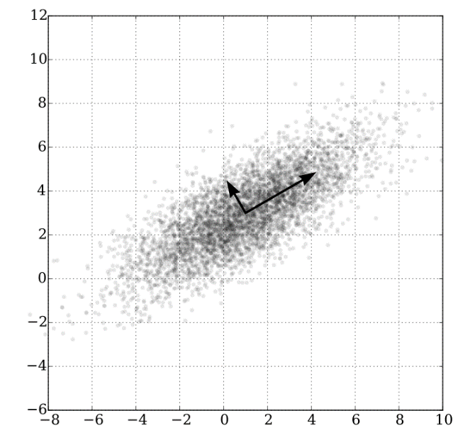
Principal Component Analysis (PCA):
Reducing Data Dimensions while retaining Maximum Variance
Direction of arrow is eigenvector
Length of arrow is eigenvalue

Slide 48
Principal Component Analysis (PCA):
Reducing Data Dimensions while retaining Maximum Variance
(3.8,5.9)
(-3.9,3.8)
A
(0.2,1.8)
(-5.5,0.3)

Slide 49
Principal Component Analysis (PCA):
Reducing Data Dimensions while retaining Maximum Variance
0.32
A
-0.11
-0.44
-0.83

Slide 50
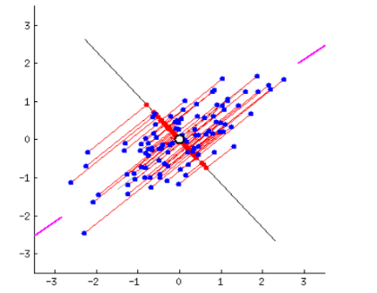
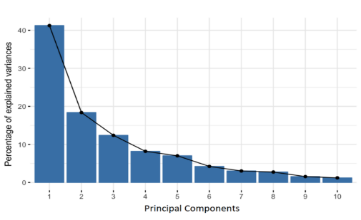
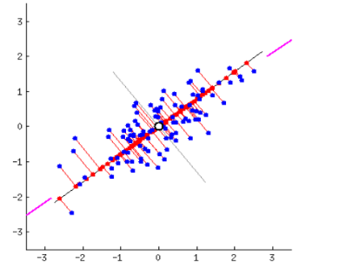
Principal Component Analysis (PCA):
Reducing Data Dimensions while retaining Maximum Variance
Principal Components represent the directions of the data that explain a maximal amount of variance, i.e. the lines that capture most information of the data.
Example: Given two dimensions, reduce to one dimension, capturing the maximum data variance
Approach: Rotate a line and project 2D data onto 1D line, find angle with greatest data variance.
projection axis
1D projection
Max Variance
Min Variance
https://builtin.com/data-science/step-step-explanation-principal-component-analysis
https://scikit-learn.org/stable/modules/generated/sklearn.decomposition.PCA.html

Slide 51
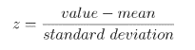
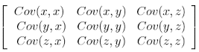
Principal Component Analysis
Standardize
Calculate Covariance Matrix (CM)
Eigenvectors and Eigenvalues of CM
Reorient features from original axis to one represented by principal components
Multiply transposed standardized dataset by the transposed feature vector
p x p matrix, examines covariance with all possible pairs of p.
For example 3 features = 3 x 3 matrix
Number of EV equal to number of matrix dimensions
Eigenvector of covariance matrix is direction of axes where the is most variation (most information). Eigenvalues are coefficients of eigenvectors; amount of variance with each principal component.
ReducedDataSet=FeatureVector^{T} * StandardizedDataSet^{T}
https://builtin.com/data-science/step-step-explanation-principal-component-analysis

Slide 52
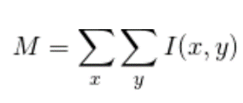
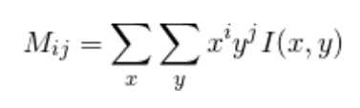
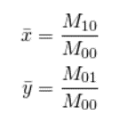

FEATURES
Simplest Moment, sum all pixels
area, aspectRatio, texture, solidity
eMajor, eMinor, contourLen, perimeter, radius, mean, std
hu_0... hu_6 HU MOMENTS
zer_0...zer_24 ZERNIKE MOMENTS
har_0...har_11 HARALICK FEATURES
gray_0...gray_4 GRAYSCALE HISTOGRAM
lbp_0... lbp_7 LOCAL BINARY PATTERNS
(1)
(2)
(3)
(4)
(5)
Complex Moment, i and j are integers (0,1,2,...)
_{First Moment is Center of Mass}
M₁₀ = x¹y⁰ *I(x,y)=x*I(x,y)
M₀₁ = x⁰y¹ *I(x,y)=y*I(x,y)
Image Moments are position-weighted sum of intensity
Central Moments subtract off centroid...
which makes them translation invariant

Slide 53


Hu Moments
Hu Moments (Hu moment invariants ) are a set of 7 numbers calculated using central moments that are invariant to image transformations. The first 6 moments have been proved to be invariant to translation, scale, and rotation, and reflection.
huMoments = -np.sign(hu)*np.log10(np.abs(hu))
https://www.learnopencv.com/shape-matching-using-hu-moments-c-python/

Slide 54


https://slideplayer.com/slide/15946917/

Slide 55
Image Reconstruction Using Zernike Moments
(a)
(b)
Reconstruction of a crane shape via Zernike moments up to order 10k-5,
k = {1,2,3,4,5}.
(c)
(d)
(e)
(f)
https://www.math.uci.edu/icamp/summer/research_11/yoo/Zernike.pptx

Slide 56

Haralick Texture Features are calculated from a Gray Level Co-occurrence Matrix, (GLCM), a matrix that counts the co-occurrence of neighboring gray levels in the image. The GLCM is a square matrix that has the dimension of the number of gray levels N in the image
https://www.researchgate.net/publication/330550795_Texture_analysis_of_magnetic_resonance_images_of_the_human_placenta_throughout_gestation_A_feasibility_study/figures?lo=1

Slide 57


GRAYSCALE HISTOGRAM
grayHist=np.zeros((5))
histogram = cv2.calcHist([grayROI], [0], None, [255], [0, 255])
grayHist[0] = histogram.mean()
grayHist[1] = histogram.std()
grayHist[2] = skew(histogram)
grayHist[3] = kurtosis(histogram)
histNorm = histogram / np.max(histogram)
grayHist[4] = entropy(histNorm)
featureList.append(grayHist.tolist())
A leptokurtic distribution is more peaked than the normal distribution. (k>3)
A platykurtic distribution is extremely dispersed points (k<3).
Kurtosis is a statistical measure that defines how heavily the tails of a distribution differ from the tails of a normal distribution.
Entropy of a histogram bucket is the entropy of the probability distribution of the values within that bucket.

Slide 58


Local Binary Patterns for Texture Classification
Divide the examined window into cells (e.g. 16x16 pixels for each cell).
For each pixel in a cell, compare the pixel to each of its 8 neighbors (on its left-top, left-middle, left-bottom, right-top, etc.). Follow the pixels along a circle, i.e. clockwise or counter-clockwise.
Where the center pixel's value is greater than the neighbor's value, write "0". Otherwise, write "1". This gives an 8-digit binary number (which is usually converted to decimal for convenience).
Compute the histogram, over the cell, of the frequency of each "number" occurring (i.e., each combination of which pixels are smaller and which are greater than the center). This histogram can be seen as a 256-dimensional feature vector.
https://ckyrkou.medium.com/object-detection-using-local-binary-patterns-50b165658368

Slide 59
Homework #12 Help

Slide 60
Homework #12 Assignment Assigned: Monday 9 Nov 2020 Due: Tuesday 17 Nov 2020 11:59 PM
1. Understanding Principal Component Analysis (PCA)
Read https://builtin.com/data-science/step-step-explanation-principal-component-analysis
Answer the following questions;
What is principal component analysis (PCA)?
Why do we standardize our features before performing PCA?
What is a covariance matrix?
What is variance and how is it calculated?
What are eigenvectors and eigenvalues? (this video give a more detailed explanation https://youtu.be/PFDu9oVAE-g)
Deliverable: Write your answers to the questions above and submit them as a pdf file named pcaReading.pdf
2. Identify Plankton in Clusters
(a) Using the trainVariety_P3.csv objectArray file and your grid clustering program from Homework #9, view and identify images of plankton in each cluster (e.g. blep,did,dil,eup,par,ste,vol). If object is not one of these give them unique names like alg1, alg2 (for algae types) or un1, un2 (for unknown types).
(b) Edit Lines 42 and 43 of “Main_Classification_Confusion_V1.py” with these new labels, e.g. replace xNames=['a','b','c','d','e','f','g','h','i','j’] with xNames=[‘blep’,’did’,...etc]
(c) Run the program and save the image of “Normalized confusion matrix”.
DELIVERABLE:
(a) Upload the “Normalized confusion matrix” image as “normalizedConfusionMatrix.png”
3. Features, PCA and TEST_SIZE
(a)Run “Main_Classification_Confusion_V1.py “ for 1, 2, and 3 PCA terms by enabling Line 15,16, OR 17 (only enable one of these lines). What is the effect on accuracy?
(b)Repeat (a) with 3 PCA terms and vary the TEST_SIZE (line 25). What is the impact on accuracy
DELIVERABLE:
(a) Upload report document named “PCA_experiments.pdf” describing the effect of PCA terms and TEST_SIZE on accuracy.
4. TEN COLORS
a) Run “Main_ViewCluster_3.py”
b)Modify the program so each of the 10 clusters have their own unique color that matches the rectangle color. [Hint: The “colorTable” must have 10 entries. It currently has only 6 entries].
DELIVERABLES:
(a)Upload your modified code as “Main_ViewCluster_10color_4.py”
(b)Upload an image of the scatter plot showing 10 unique colors as “TenColor.png”

Slide 61
ReadMe_HW12_Code.txt
Main_DetectTrackFeatureCluster_2.py
Loads a video, performs detection, tracking, feature detection and clustering, saves objectArray.
Main_Cluster_9.py
Loads an objectArray, clusters objects, writes clusters to objectArray, saves objectArray.
Main_HowManyInCluster.py
Counts number of members in each cluster and prints results.
Main_ViewCluster_3.py
Loads an objectArray and video, display scatter plot of of PCA terms or area, texture and aspect ratio of all objects for all frames, while viewing video.
Main_PCA_1.py
Loads an objectArray, scales features to be zero mean and variance of one, calculates and inserts PCA values into objectArray, saves objectArray.
Main_Classification_Confusion_V1.py
Loads an objectArray, splits objects into test and train datasets, classify with decision tree classifier, calculate accuracy and generate confusion matrix.
trainVariety_P3.csv
objectArray with extended features (68), samples every third object in a tracklet
trainVariety_P10.csv
objectArray with extended features (68), samples every tenth object in a tracklet

Slide 62

did
par
blep
eup
ste
dil
vol

Slide 63

10x10 Grid Array of Cluster #1

